Slide 1



Impact Of Internet Usage On Sleep Patterns Among Young Adults
2
0
2
4

Slide 2




01
Introduction
Correlation Coefficient Analysis
05
02
Key factors & Their Impact
Regression Analysis
06
03
Objectives
Result & Discussion
07
04
Dataset Description
Conclusion & Recommendations
08

Slide 3

01
Introduction
Use of the internet is essential for learning, socializing particularly for young adults.
Excessive internet use affecting sleep patterns and health.
Understanding the relationship between technology and sleep and addressing the health challenges faced by today's youth.
Time spent on internet & Sleep hours.
Time spent on internet & Time take to fall sleep.
Staying up to use internet & Hours of sleep.
Analyzing technology and sleep
Notes:
2ab47d68-e4ac-4ccf-9f4f-a38632be634c.source.default.zh-Hans

Slide 4
02
Key factors & Their Impact
Time taken to fall asleep
Staying up to use internet
Melatonin, the hormone that controls sleep-wake cycles, blue light affect this cycle.
Disrupt natural sleeping and poor sleep. Irregular sleep affect daytime functioning.
02
04
01
03
05
Time spent on internet
Average sleep hours
Negative feeling
Continuous usage of the internet especially after midnight affect the brain and leading to more difficult to relax before bed.
Affects cognitive functioning, emotional regulation, and overall physical sleep deficits
This emotional distress can interfere with restlessness, rumination, and increased stress level.

Slide 5
03
Objectives
01.Relationship between time spent on internet
Examine the effect of internet use on restfulness sleep problems.
02.Correlation between internet use of before bed & fall sleep
Identify which certain online activities cause sleep delay.
03.Impact of Internet usage in adult's sleep
Check who use the internet frequently sleep less than advised.
04.Late night internet use & effect on sleep patterns
Examine how sleep patterns affect.
05.Emotional and psychological effect of internet
How these feelings impact the length and quality of sleep by causing tension or anxiety.

Slide 6
04
Dataset Description

Slide 7
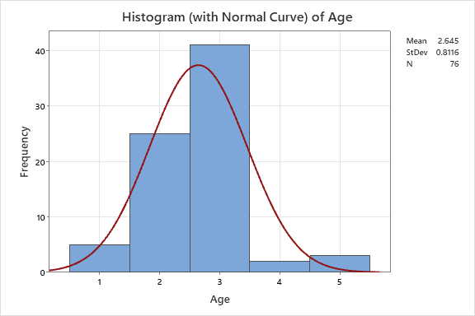
Original Value | Recoded Value |  | Number of Rows
15 - 17 years old | 1 |  | 5
18 - 21 years old | 2 |  | 25
22 - 24 years old | 3 |  | 41
25 - 27 years old | 4 |  | 2
More than 27 | 5 |  | 3
Source data column |  | Age
Recoded data column |  | Recoded Age

Slide 8
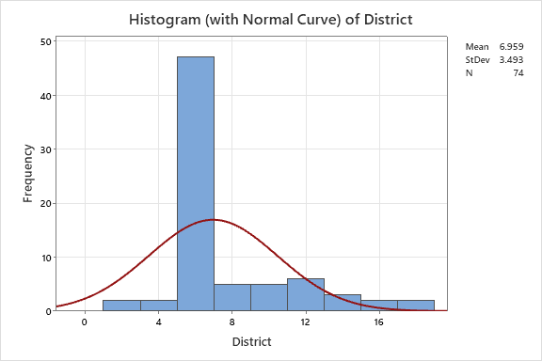
Original Value | Recoded Value |  | Number of Rows
Badhulla | 1 |  | 1
Badulla | 2 |  | 1
Gampaha | 3 |  | 1
Good | 4 |  | 1
Kandy | 5 |  | 37
Kandy | 6 |  | 10
Kegalle | 7 |  | 3
Kegalle | 8 |  | 2
Kndy | 9 |  | 1
Kurunegala | 10 |  | 4
Kurunegala | 11 |  | 5
London | 12 |  | 1
matale | 13 |  | 1
Matale | 14 |  | 2
Matale | 15 |  | 1
Monaragala | 16 |  | 1
Nuwara eliya | 17 |  | 1
කුරුණෑගල | 18 |  | 1
 | * |  | 2
Source data column |  | District
Recoded data column |  | Recoded District

Slide 9
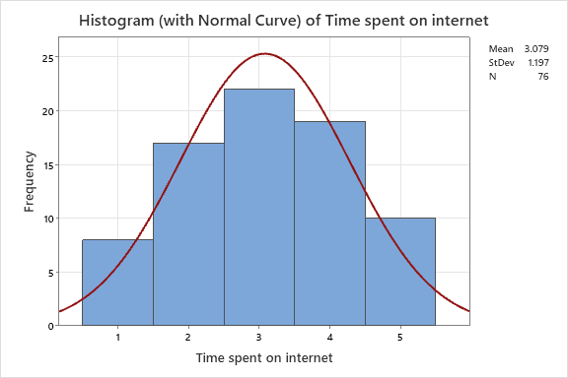
Original Value | Recoded Value |  | Number of Rows
0 - 2 hours | 1 |  | 8
2 - 4 hours | 2 |  | 17
4 - 6 hours | 3 |  | 22
6 - 8 hours | 4 |  | 19
More than 8 | 5 |  | 10
Source data column |  | Time spent on Internet

Slide 10
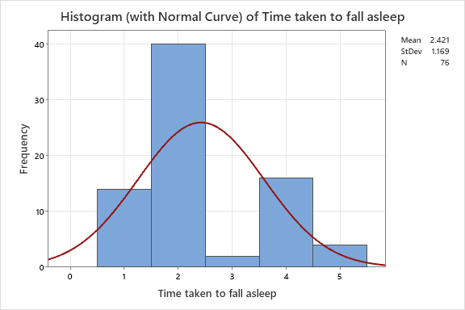
Original Value | Recoded Value |  | Number of Rows
1 Hour | 1 |  | 14
15 Minutes | 2 |  | 40
2 Hour | 3 |  | 2
30 Minutes | 4 |  | 16
More than 3 hours | 5 |  | 4
Source data column |  | Time taken to fall asleep
Recoded data column

Slide 11
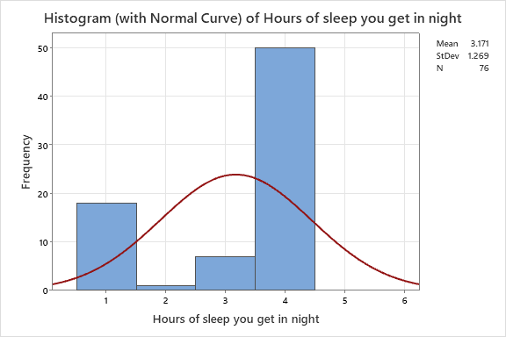
Original Value | Recoded Value |  | Number of Rows
5 hours | 1 |  | 18
7/6hr | 2 |  | 1
less than 5 hours | 3 |  | 7
More than 5 hours | 4 |  | 50
Source data column |  | Hours of sleep you get
Recoded data column |  | Recoded Hours of sleep you get

Slide 12
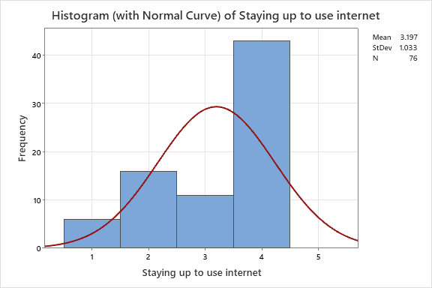
Original Value | Recoded Value |  | Number of Rows
Never | 1 |  | 6
Often | 2 |  | 16
Rarely | 3 |  | 11
Sometimes | 4 |  | 43
Source data column |  | Stay up to use internet
Recoded data column |  | Recoded Stay up to use internet

Slide 13
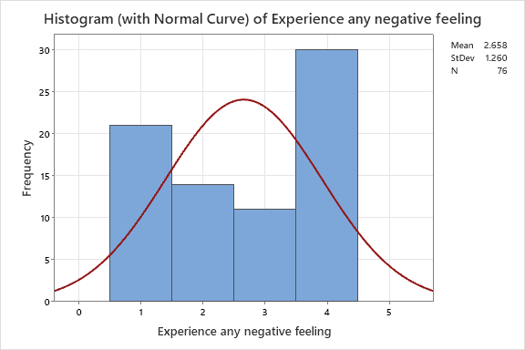
Original Value | Recoded Value |  | Number of Rows
Never | 1 |  | 21
Often | 2 |  | 14
Rarely | 3 |  | 11
Sometimes | 4 |  | 30
Source data column |  | Experience any negative feeling
Recoded data column |  | Recoded Experience any negative

Slide 14

Descriptive Statistic
Variable | Mean | StDev | Variance | CoefVar | Sum | Q1 | Median | Q3
Age | 2.6447 | 0.8116 | 0.6588 | 30.69 | 201.0000 | 2.0000 | 3.0000 | 3.0000
District | 6.959 | 3.493 | 12.204 | 50.20 | 515.000 | 5.000 | 5.000 | 8.250
Time spent on internet | 3.079 | 1.197 | 1.434 | 38.89 | 234.000 | 2.000 | 3.000 | 4.000
Time taken to fall asleep | 2.421 | 1.169 | 1.367 | 48.29 | 184.000 | 2.000 | 2.000 | 4.000
Hours of sleep you get in night | 3.171 | 1.269 | 1.610 | 40.02 | 241.000 | 2.250 | 4.000 | 4.000
Staying up to use internet | 3.197 | 1.033 | 1.067 | 32.31 | 243.000 | 2.000 | 4.000 | 4.000
Experience any negative feeling | 2.658 | 1.260 | 1.588 | 47.41 | 202.000 | 1.000 | 3.000 | 4.000
Variable | Mode | N for Mode
Age | 3 | 41
District | 5 | 37
Time spent on internet | 3 | 22
Time taken to fall asleep | 2 | 40
Hours of sleep you get in night | 4 | 50
Staying up to use internet | 4 | 43
Experience any negative feeling | 4 | 30

Slide 15
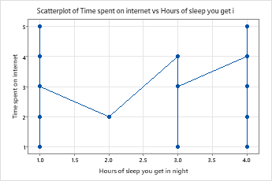
05
Correlation Coefficient Analysis
Time spent on Internet VS Hours get sleep in night
Correlation coefficient = 0.070.
It indicates a Positive but very weak relationship(0.7+ =strong).
Slight tendency increase between these two variables.

Slide 16
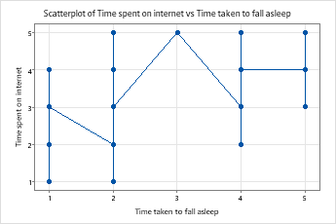
Internet usage VS Time taken to fall asleep
Correlation coefficient = 0.166.
It indicates a Positive but very weak relationship.
Slight tendency increase between these two variables.

Slide 17
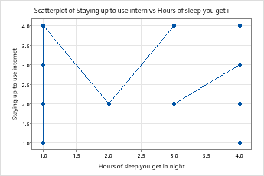
Staying up VS Hours you sleep
Correlation coefficient = (-0.016).
It indicates a very weak Negative relationship.
Slight tendency decrease between these two variables.

Slide 18
06
Regression Analysis
Time spent on internet=2.666 + 0.170 Time taken to fall asleep
Time spent on Internet VS
Hours you get sleep in night
Staying up vs hours you sleep
Intercept = 2.870
Slope = 0.1493
Intercept = 2.870
Slope = 0.1493
Positive Relationship
Positive Relationship
Negative Relationship
Internet usage VS time taken to fall asleep
Intercept = 2.666
Slope = 0.170
Time spent on internet=2.870 + 0.066 Hours of sleep you get in night
Staying up to use internet=3.238 - 0.0130 Hours of sleep you get in night
Notes:
Y = b0 + b1*x
Intercept = b0
Slope = b1

Slide 19

07
Result & Discussion
The relationship between internet usage and sleep duration is very weakly positive and more internet use has a small effect on sleep duration.
Time to Fall Asleep and Internet Usage: There is a weak positive relationship and more internet use results in a little longer time to fall asleep.
Sleep Duration and Staying Up Late for Internet Use: Very weak negative connection and there is very little impact from staying up late for internet use on sleep duration.

Slide 20
08
Conclusion & Recommendations
The use of the internet has only mild effects on sleep patterns
Personal actions and other factors likely have a higher impact on sleep disruption than does internet usage alone.
Reducing internet use before bedtime may improve sleep quality slightly but addressing other lifestyle factors may be more effective.
Recommendations
Improve Sleep Hygiene.
Limit Internet use before Bedtime.
Change lifestyle factors.
Promote Relaxation.

Slide 21














Thank you

